Slide 1
0x405 – Binary Formats
ECED4406 – Computer Security
Dr. Colin O’Flynn
Dalhousie University.

Slide 2
What is a “Binary”??
But everything in the computer world is binary!?
In cybersecurity parlance, binary normally means some low-level code, possibly being able to directly execute (an ‘executable’).
Normally a binary is directly in the format that the machine can use.
This is far from a definition – there is a lot of flexibility here….
The binary may be encrypted still, so is not always an executable.
On Windows - .EXE is example of a binary file (but in embedded .exe is rare).

Slide 3
Example of file formats you might run into:
BIN: Binary
HEX: Intel Hex
S19: Motorola S19 File
ELF: Executable and Linkable Format (also - Extensible Linking Format)
OBJ: Object File
Some of these file formats encode the data into “text representation”. This isn’t binary per my earlier definition. But in reality, it’s trivial to translate so these are used interchangeable in practice.

Slide 4
Features of File Formats
Executable data
All of them will include some level of executable data… otherwise what’s the point?
Address information
Normally we need to know where information is to be stored. A raw file (binary) contains no additional metadata like this.
Section names
Rather than just addresses, we might like to have section names (like __BOOT__).
Debugging symbols
Debugging symbols contain information such as the function names as in the original program. The low-level code doesn’t include this, as the computer does not care what you named your variables, functions, etc.
Other metadata

Slide 5
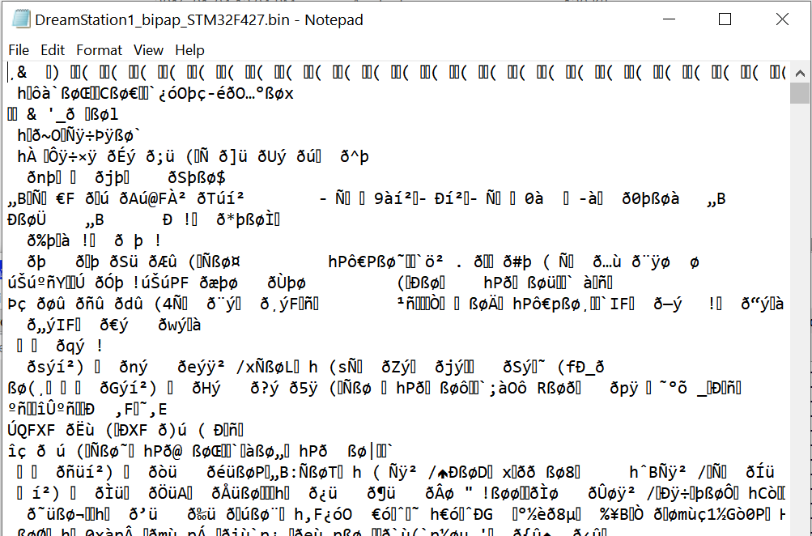
Example: Binary File

Slide 6
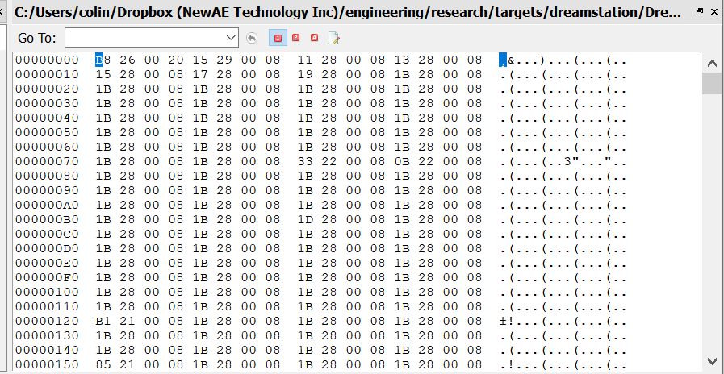
Example: Binary File
Starting address is from 0

Slide 7
Binary Files
Contain only raw data.
Does not contain any other data:
No addressing.
No headers.
No sections.
No debugging.

Slide 8
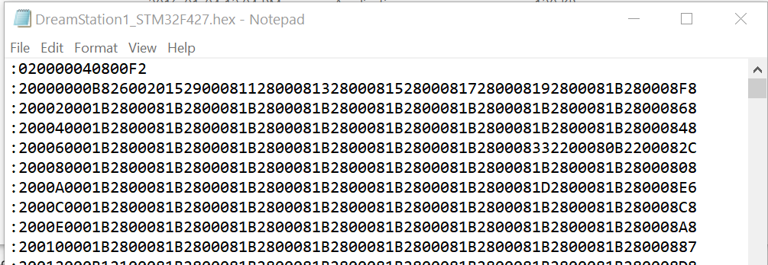
Example: Intel Hex
Opened in notepad… hard to see format.

Slide 9
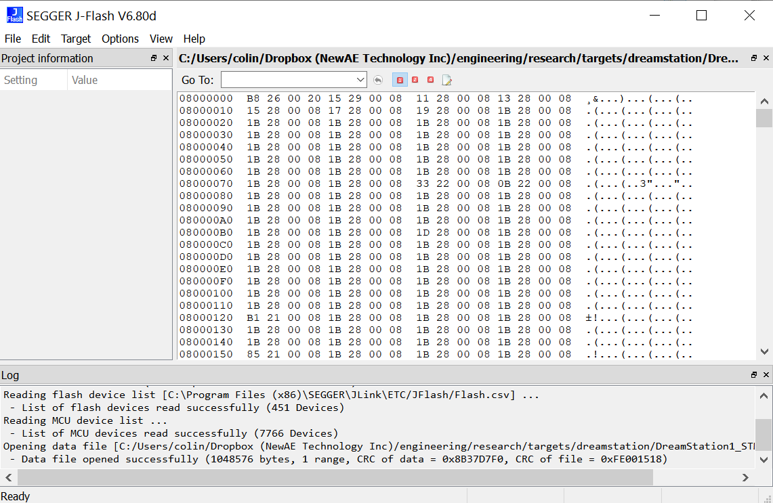
Example: Intel Hex

Slide 10
Intel Hex
Intel hex (normally .hex extension) contains text-based file (not super efficient on size).
Includes address information.
Does not include debug information.

Slide 11
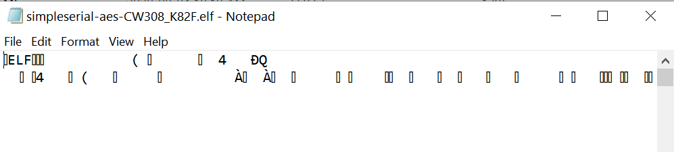
ELF File

Slide 12
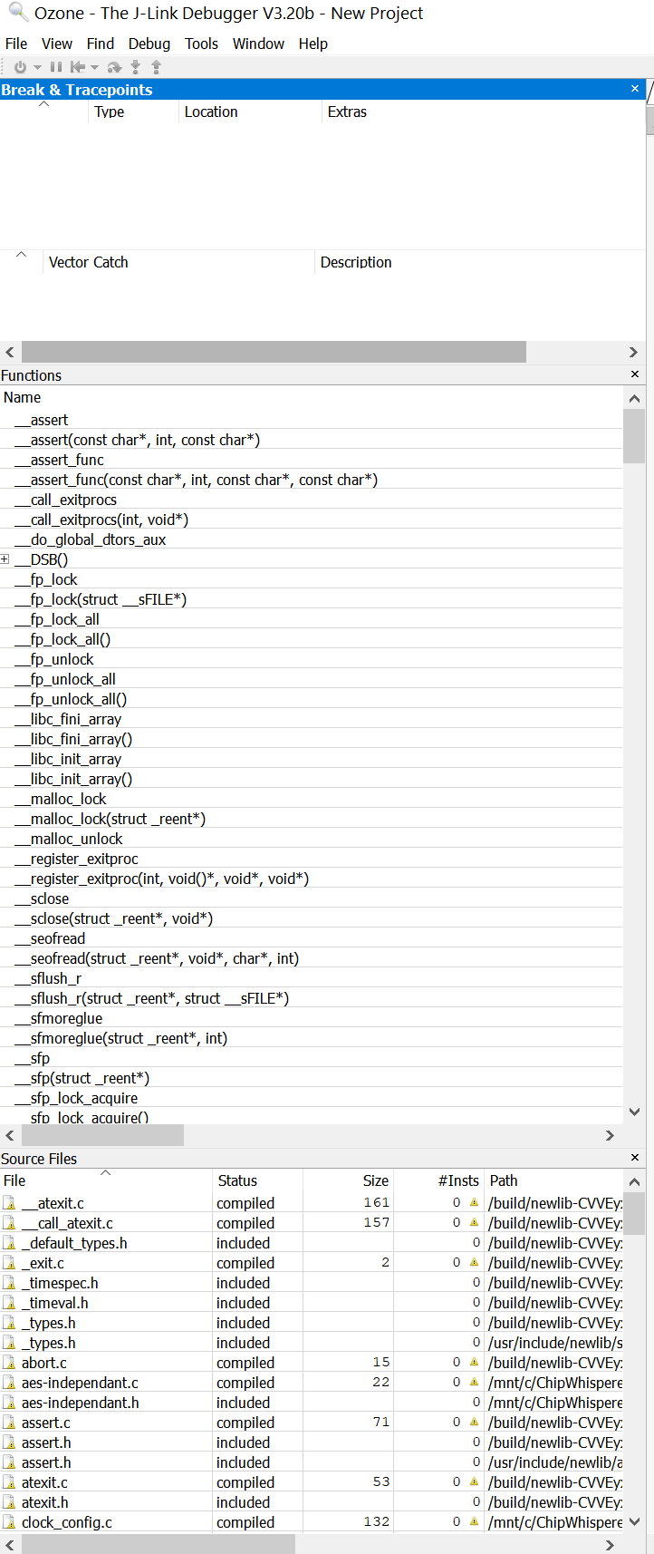
ELF File
Debug symbols!

Slide 13
ELF File
ELF file contains binary data.
Highly flexible – it may contain debug symbols (good for reverse engineering).
Can contain multiple sections, files within it, etc.

Slide 14
Binary File Formats
A binary file may or may not be an executable.
An executable can be run directly by the machine.
The binary file may be only an update, or may be encrypted etc.
Several formats available, but in embedded systems you are most likely to run into only a few versions:
.BIN – Raw Binary (read from a device for example)
.ELF – Very common in embedded linux systems

